Slide 1

Department of Information Technology
NBA Accredited A.P. Shah Institute of Technology G.B.Road,Kasarvadavli, Thane(W), Mumbai-400615 UNIVERSITY OF MUMBAI Academic Year 2020-2021

Slide 2
A Project Report on
Machine-Learniing based Autonomous Riding System (M.A.R.S) Submitted in partial fulfillment of the degree of Bachelor of Engineering(Sem-8) in INFORMATION TECHNOLOGY
By Fenil Bhimani - 19204012 Om Bheda - 19204011 Amey Mohite - 18104067 Under the Guidance of Prof. Apeksha Mohite

Slide 3
1.Project Conception and Initiation

Slide 4
1.1 Abstract
Vision begins in eyes, but truly takes place in the brain. So, in today’s world with the best high-definition cameras, high-speed computers, and artificial intelligence, computer vision was introduced. Computer vision is one of the latest advancements in technology that helps on giving the abilities of vision and understanding of the environment to computers so that they can extract high-level understanding from digital images and videos.
Autonomous vehicles are the application of computer vision with main motive of eliminating human errors and drive the vehicles with high precision and remove the efforts taken by a person to drive and to take advantage of the technology for travelling around safely and securely.

Slide 5
1.1 Abstract
To create a completely autonomous system capable of navigating around on its own. Detect, identify and follow traffic signs, signals and rules. Take appropriate actions for dynamic conditions and avoid any sort of loss. Provide user with an application interface to experience a safe journey to selected destination.
The autonomous driving model to be deployed, will be trained using YOLO for object detection and identification, along with a vehicle behavior prediction subsystem assisting the dynamic decision-making subsystem to take some decisions based on the prediction to reduce severity of certain accidents or even avoid them, before they happen.

Slide 6
1.2 Objectives
To design, fabricate and develop a completely autonomous scaled down vehicle using latest trends in the field of Computer Vision, AI and Embedded Systems as per the feasibility.
To apply an algorithm that can find the shortest path with respect to distance in the scaled down map created.
To orchestrate a system that detects, identifies, and follows the traffic signs and rules on the roads.
To create a system that morally and ethically takes dynamic action for any implausible condition that occurs.
To provide user with an application interface that has an overwrite command with higher priority than the system commands.

Slide 7
1.2 Objectives
To understand new technologies, hardware and implement the same in a feasible manner.
To manage the entire project in a professional manner by cost management, team management and waste management strategies.

Slide 8
1.3 Literature Review
Title – Building a Self-Driving RC Car Master’s Thesis
Publication – Master’s thesis to University of Zagreb, 2020
Author Name – Ivan Orˇsolic´
Conclusion – [3]In the thesis the author created a self-driving RC car using Embedded Systems, OpenCV, DonkeyCar, Keras methodologies. The paper showed detailed description regarding the hardware and the software used in the project. It included comparisons, setting up of the environment and connections for the components used. It introduced to the DonkeyCar library that is developed for creating self-driving cars similar to that of the scope of our project. The entire project was quite similar to the ideas that we have and implemented some of the objectives that we used. Overall, the thesis paper solved a few doubts and discrepancies regarding the hardware selection and gave a new light on DonkeyCar.

Slide 9
1.3 Literature Review
Title – Comparative Analysis of Machine Learning Algorithms on Different Datasets
Publication – International Conference on Innovations in Computing (ICIC), 2017
Author Name – Kapil Sethi, Ankit Gupta, Gaurav Gupta, Varun Jaiswal
Conclusion – [1]In the paper the authors used MATLAB to simulate the working of different algorithms for varying datasets. The sensitivity and accuracy of NN, SVM and KNN are determined from the simulations. The schema used by the authors for the experiment was identified and as per the examination, SVM classifier contrasted better than KNN and NN with accuracy of close to 99.38

Slide 10
1.3 Literature Review
Title – Autonomous Vehicles and Embedded Artificial Intelligence: The Challenges of Framing Machine Driving Decisions
Publication – XIII Conference on Transport Engineering, CIT2018
Author Name - Martin Cunneen, Martin Mullins, and Finbarr Murphy
Conclusion – [2]The paper covered the moral decisioning problems faced by algorithms while driving. How not having an emotional quotient may affect the weighted inputs and their corresponding outputs. This paper focused more on ethical challenges as well as the social dilemma that can revolve around autonomous cars and how over-fitting of data while training can make the AI model biased to certain aspects and how this problem is solved by having appropriate diversified datasets and sufficient training of the model.

Slide 11
1.4 Problem Definition
Every year, traffic accidents account for 2.2% of global deaths. That stacks up to roughly 1.3 million a year — 3,287 a day. On top of this, some 20–50 million people are seriously injured in auto-related accidents each year. The root of these accidents? Human error.
Unintentional or foolish interruptions caused by the pedestrians, domestic animals and other drivers on road results in accidents and loss of both health and wealth.
In 2020, 10,010 four-wheelers were towed away for wrong parking and a fine of Rs 85,73,642 was recovered.
People having disabilities require drivers to carry them around or have to modify their cars with attachments which costs them a lot of money.

Slide 12
1.5 Scope
Proof of concept of Autonomous Vehicles.
Design of highly efficient completely autonomous commercial cars.

Slide 13
1.6 Technology stack
Hardware –
GSM Module
Nvdia Jetson Nano 2GB Developer Kit
Li-Po Batteries
L298D – motor driver
Battery operated DC Motor
LiDar
Servo motor
Camera
Ultra-sonic sensors

Slide 14
1.6 Technology stack
Software –
Flutter
Firebase
Python
OpenCV2
Tensorflow
Keras Framework
Jetpack SDK – OS development Board
You Only Look Once Algorithm ( YOLO) – object detection
Dijkstra Algorithm – shortest path finding
Nvidia Disco box Image Segemtation

Slide 15
1.7 Benefits for environment & Society
Every year, traffic accidents account for 2.2% of global deaths. That stacks up to roughly 1.3 million a year — 3,287 a day. On top of this, some 20–50 million people are seriously injured in auto-related accidents each year. The root of these accidents? Human error.
Unintentional or foolish interruptions caused by the pedestrians, domestic animals and other drivers on road results in accidents and loss of both health and wealth.
In 2020, 10,010 four-wheelers were towed away for wrong parking and a fine of Rs 85,73,642 was recovered.
People having disabilities require drivers to carry them around or have to modify their cars with attachments which costs them a lot of money.
Above stated points will be encountered by our proposed system and this will be beneficial for our society

Slide 16
2. Project Design

Slide 17
2.1 Proposed System
Our proposed system architecture will be a completely autonomous riding system scaled down to the size of an Rc-sized car that will have its own –
Environment sensing techniques for detection and identification of objects.
Decision making system driven by traffic rules and selective moral/ethical values.
Prediction model to predict certain movements in environment and prevent/minimise harm caused from severe accidents, by taking actions before they occur.
Shortest path finding system to find the route with shortest distance to reach the destination.
Hardware system with actuators for smooth movement of car based on commands given by the decision-making system.
Mobile Application that will have the options for selecting destination, starting and stopping, and video feedback from car’s cameras. The rider in the car will also have
override access to the cars control for emergency through the mobile application.

Slide 18
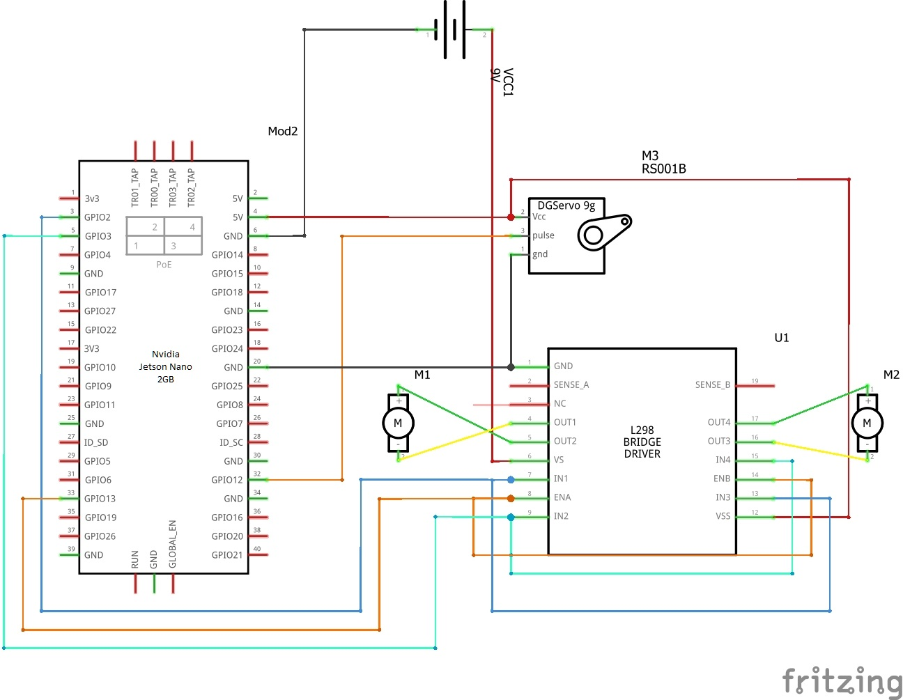
2.2 Design
Figure 2.2.1 – Circuit

Slide 19
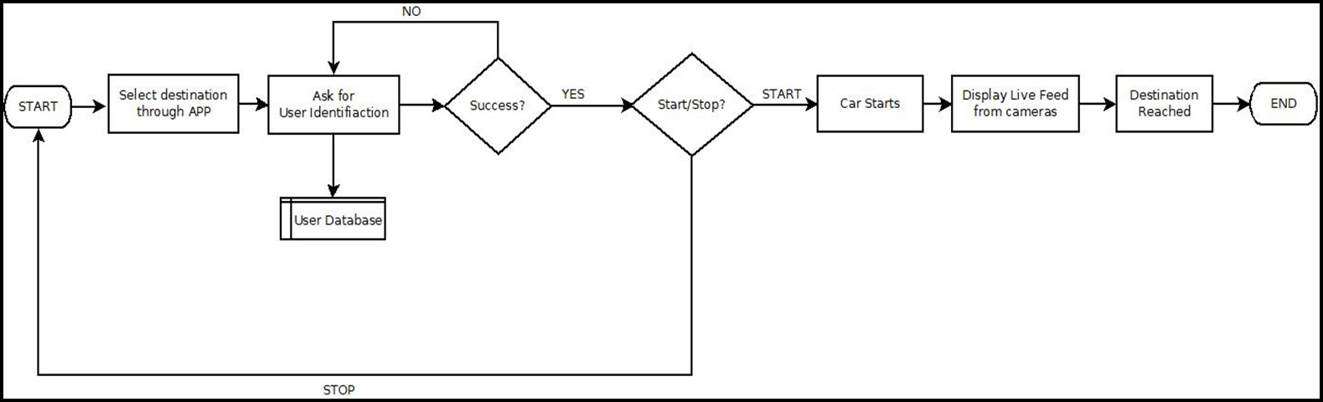
2.2 Design
Figure 2.2.2 – Application Flow

Slide 20
3. Implementation

Slide 21
4. Testing

Slide 22
Types of Testing performed –
Unit Testing
Integration Testing
Load Testing
Model Testing

Slide 23
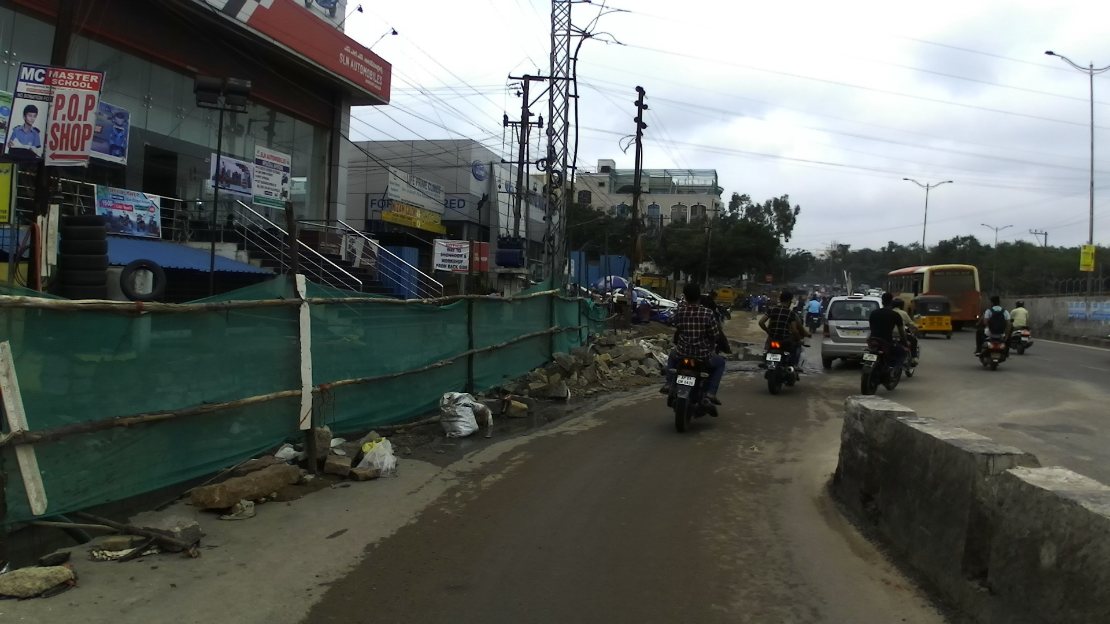
Figure 4.1 – Input Image

Slide 24
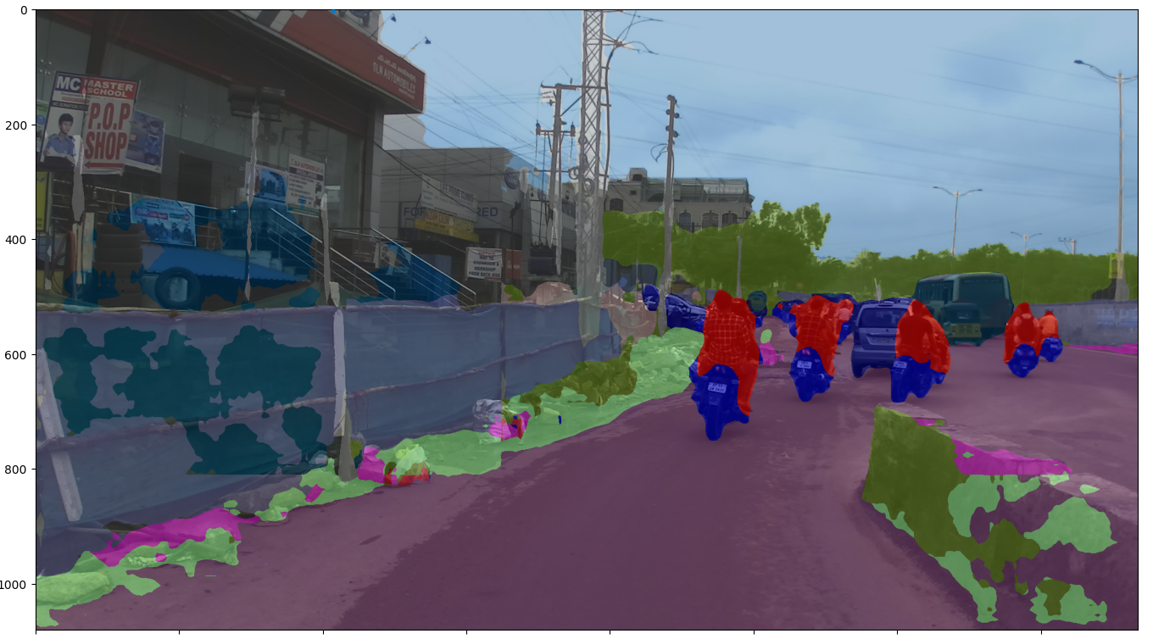
Figure 4.2 – Custom Trained Model output

Slide 25
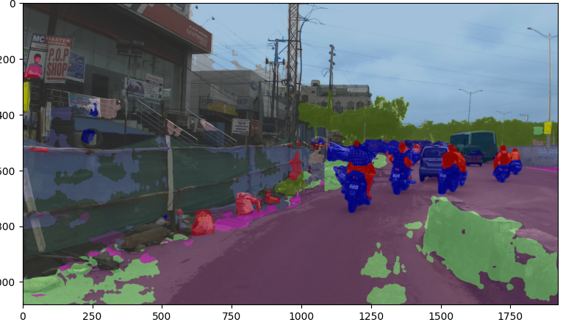
Figure 4.3 – Pre- Trained Model output

Slide 26
5. Conclusion and Future Scope

Slide 27
Conclusion
By this we understand the design and methods of implementing a fully autonomous RC-sized car, i.e. highly modular and easily scalable.
This project also is a great way in which one can learn about technologies like Embedded Systems, Computer Vision, and Autonomous Vehicles as a whole.
The literature review from different published papers gave a clear idea on the different perspectives of implementing autonomous systems.

Slide 28
Future Scope
Implementation on Real – Scale in APSIT’s Modified Auto Club.
Customized Dataset.
Training for Robust and undisciplined driving conditions E.g. – Mumbai.
Prediction models have become a necessity, a simple autonomous riding system along with faster processing is not enough to fulfil the rising demands of today’s traffic scenarios. The use of open-source techniques for the implementation of the subsystems is made clear.

Slide 29
References
Kapil Sethi et al. “Comparative Analysis of Machine Learning Algorithms on Different Datasets”. In: Circulation in Computer Science International Conference on Innovations in Computing (ICIC) (2017), pp. 87–91.
Martin Cunneen Finbarr Murphy Martin Mullins. “Autonomous Vehicles and Embedded Artificial Intelligence: The Challenges of Framing Machine Driving Decisions”. In: Applied Artificial Intelligence 33.8 (2019), pp. 706–731. DOI: https://doi.org/10.1080/08839514.2019.1600301.
Ivan Orˇsolic´. Building a Self-Driving RC Car Master’s Thesis. 2020. URL: https://bib.irb.hr/datoteka/1071914. 5e4dc43800410 Building a Self - Driving RC Car -
Ivan Orsolic 0016114170 Masters thesis.pdf.

Slide 30
Paper Publication
Paper Title: RC-sized Autonomous Vehicle with Prediction Model
Students Name:
Om Bheda - 19204011
Fenil Bhimani - 19204012
Amey Mohite – 18104067
Guide Name: Prof. Apeksha Mohite.
Conference Name: IEEE International Conference for Convergence in Technology(I2CT 2022).
Paper Status: Published.

Slide 31
Thank You

